Slide 1
R and RStudio installation
R: https://cloud.r-project.org/
RStudio: https://posit.co/download/rstudio-desktop/
Course material
GitHub repo:
https://github.com/BioinfoHKUSurgery/Bioinfo-Workshop-2024

Slide 2
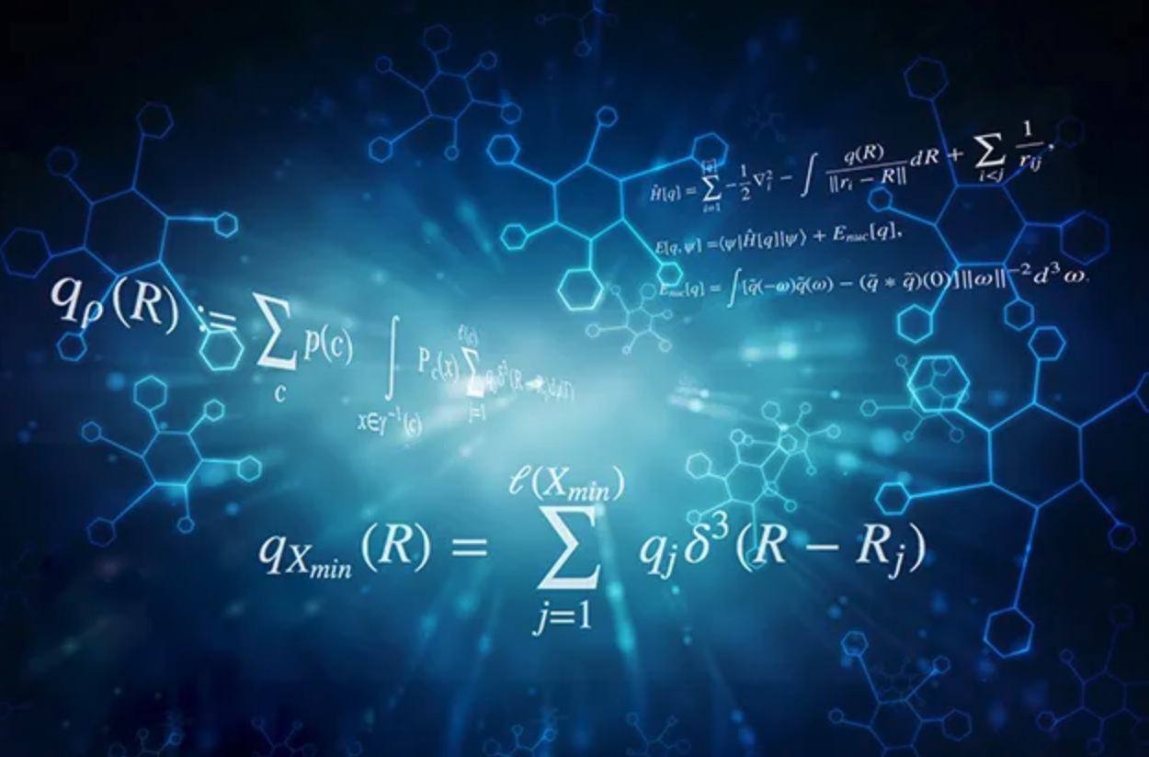
Machine Learning
Paul, Clara

Slide 3
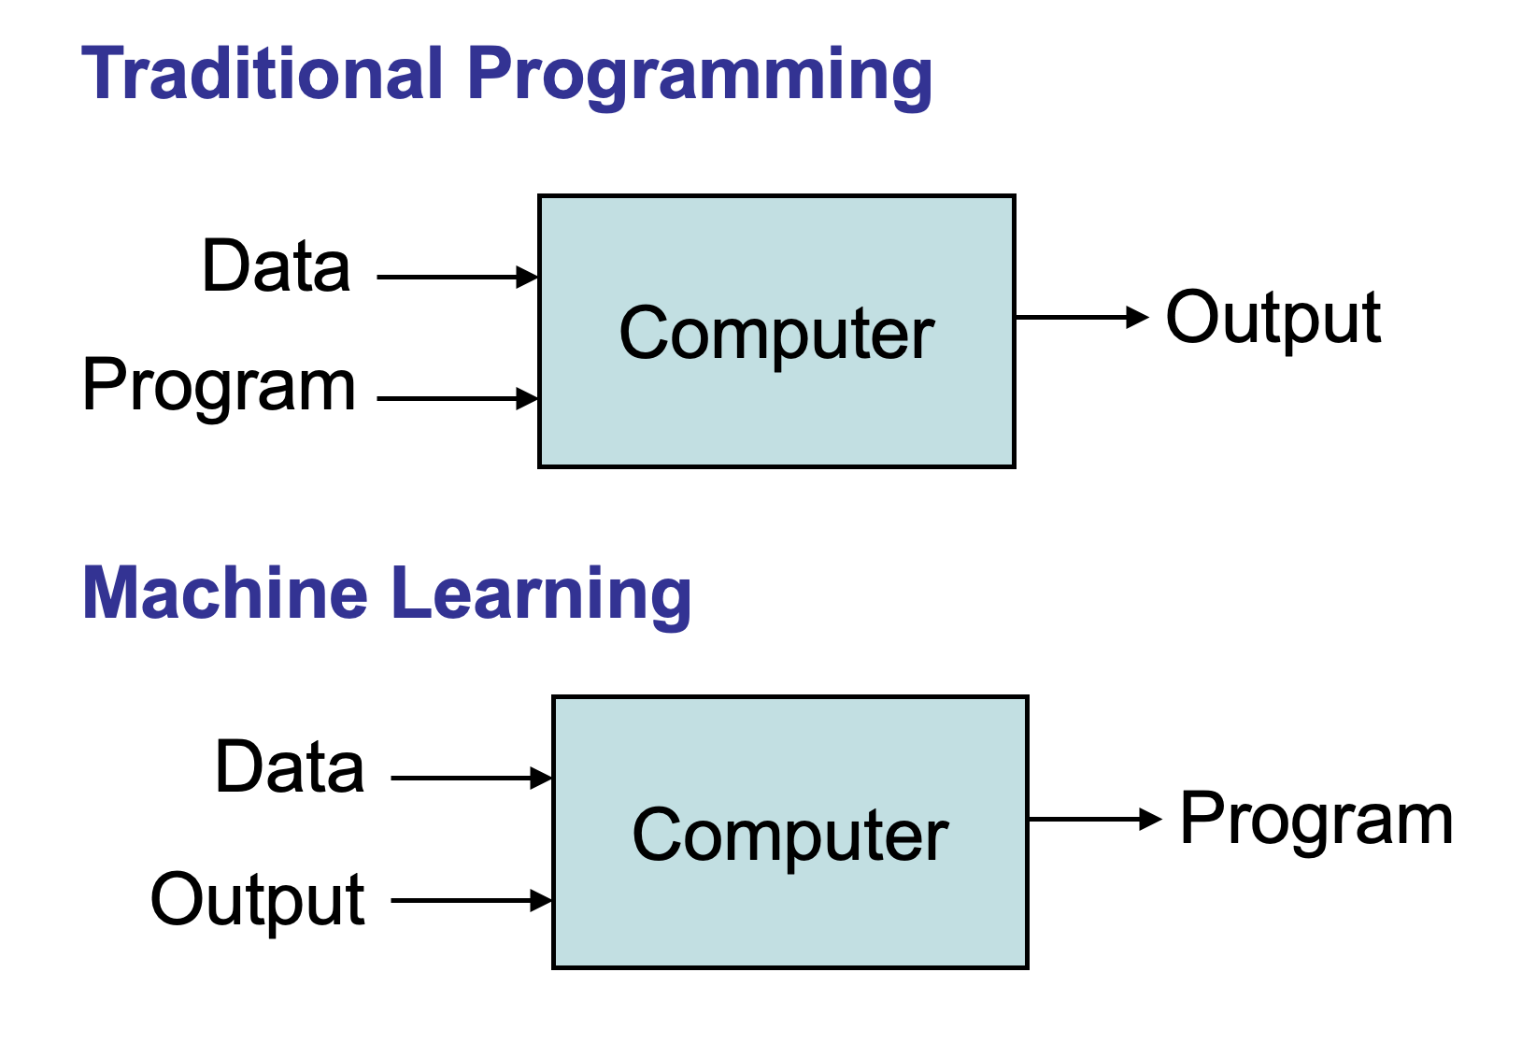
What is Machine Learning?
A subfield of artificial intelligence (AI) that uses algorithms trained on data sets to create self-learning models capable of predicting outcomes and classifying information without human intervention.
The training step of machine learning involves learning patterns in the data and the optimization of model parameters which generalize to new unseen data.
Once the model is trained and tested, accurate predictions can be made fast and efficiently based on new input data.

Slide 4
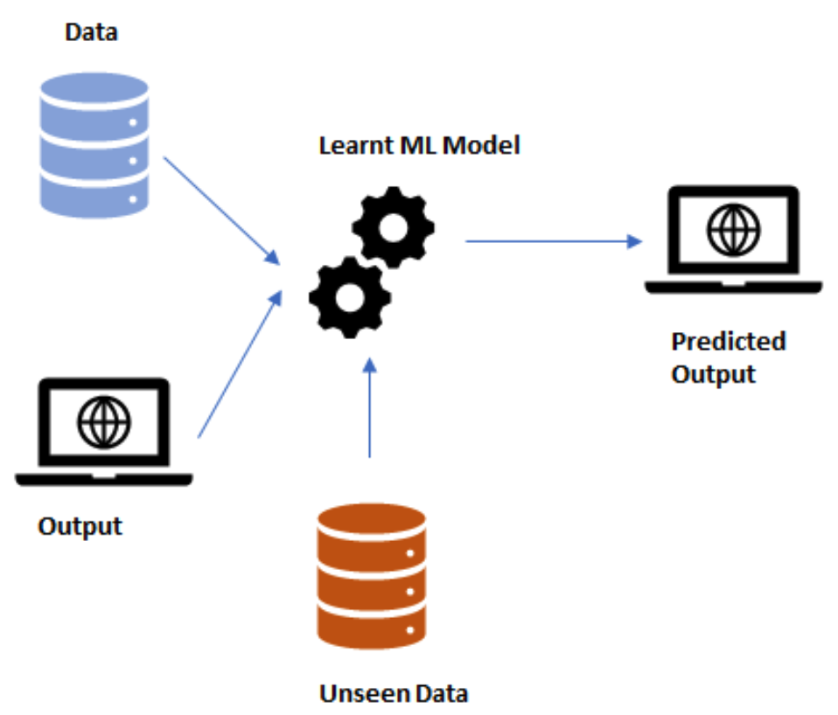
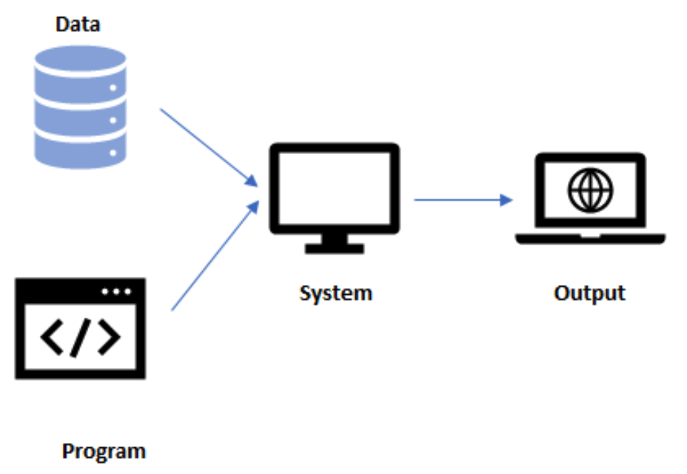
What is Machine Learning?
Traditional Programming
Machine Learning

Slide 5
Machine Learning vs Statistics
Machine Learning
A subfield of computer science (AI)
Focus is on making accurate predictions and classification of data
No prior knowledge about the data required
Usually applied to large, high-dimensional data
Statistics
A subfield of mathematics
Focus is on finding relationships between variables and their significance
Some prior knowledge about the data required
Usually applied to small-to-mid sized data with low dimensionality

Slide 6
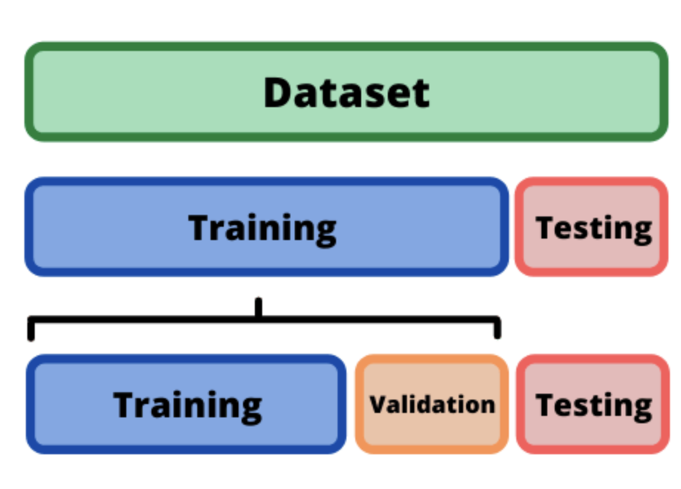
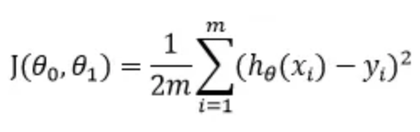
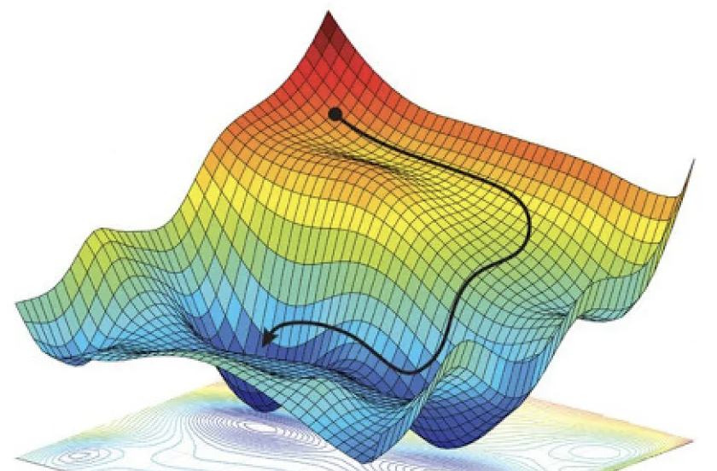
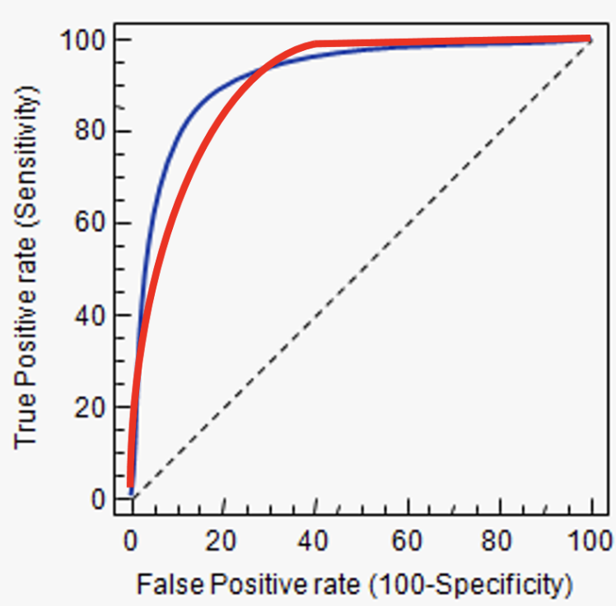
Model training and cross validation
The goal of model training is to find the optimal set of model parameters that minimize the difference between the predicted output values and the actual output values
This process usually involves an optimization algorithm that iteratively adjusts the model parameters to improve the model's performance.
Model parameters are optimized by minimizing a cost function:
Widely used optimization algorithms include stochastic gradient decent, simulated annealing, and genetic algorithms.
The performance of the model on real unseen data can be evaluated using cross-validation, whereby during training a portion of the data is held-out and reserved for validation and testing only
Parameter optimization
Model evaluation
stochastic gradient decent
ROC-AUC

Slide 7
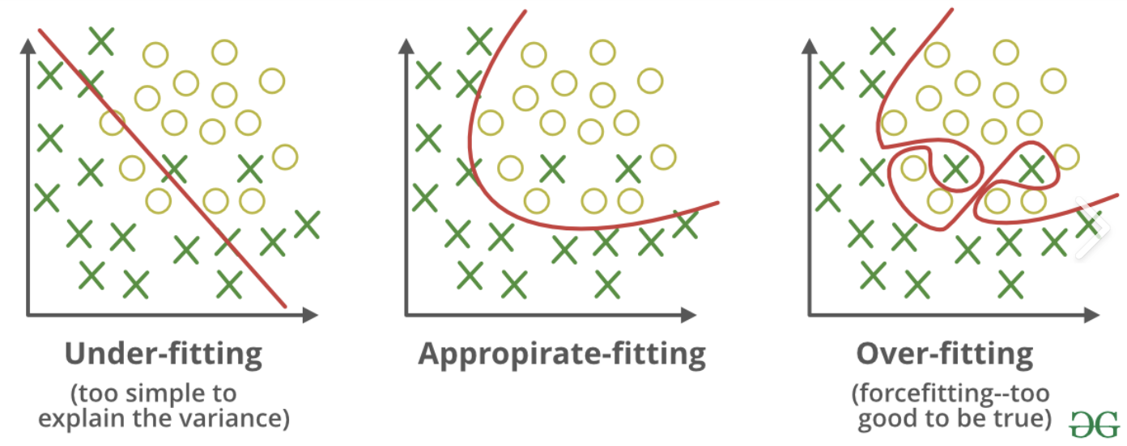
Overfitting & Underfitting
Overfitting occurs when a model learns the training data too well, capturing not only the underlying patterns but also the noise and random fluctuations.
Characterized by high accuracy on the training data, but low performance on new, unseen data.
Occurs if the model is too complex or when it has too many features relative to the amount of training data.
Solution: Reduce model complexity, Regularization, reduce number of features
Underfitting occurs when a model is too simple to capture the complexities in the data. It fails to learn the training data effectively.
Characterized by poor performance on both training and testing data.
Can be caused by insufficient features or or small training dataset.
Solution: Increase model complexity, Enhance feature representation, or use less regularization.

Slide 8
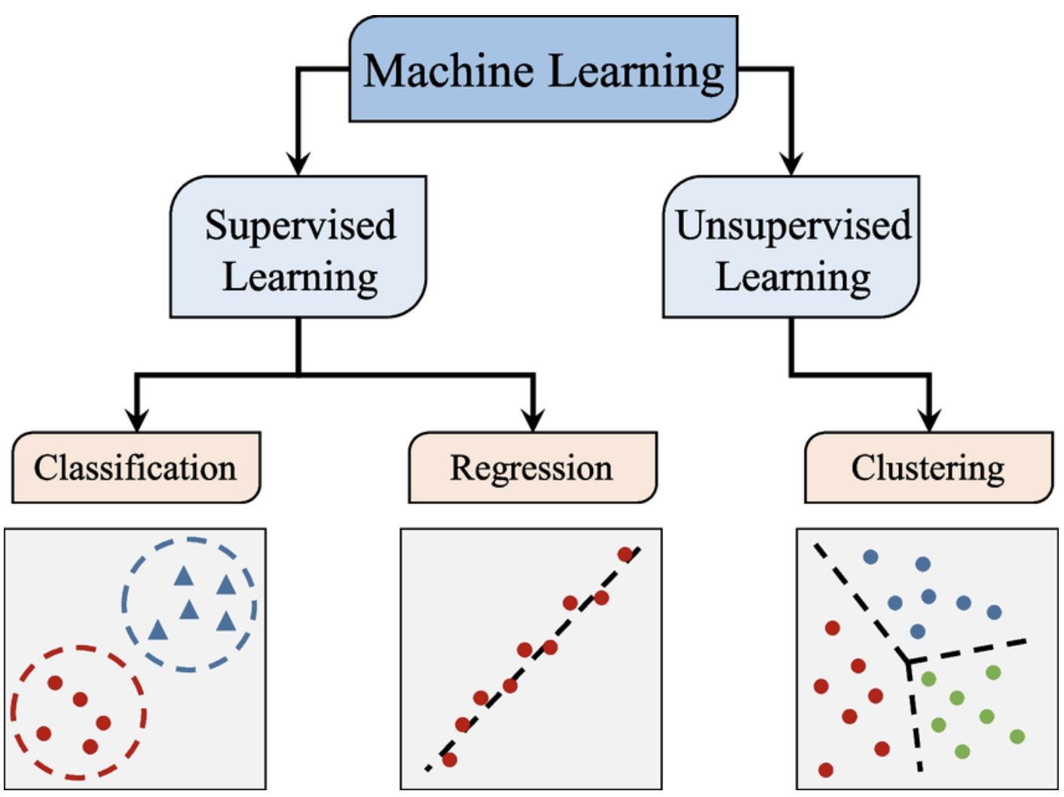
Types of machine learning
Supervised learning: training on labelled data, where the output variables are known. The goal of supervised learning is to learn a model that can accurately predict the output values for new input data.
Unsupervised learning Training on unlabelled data, where the output variables are unknown. The goal of unsupervised learning is to learn patterns and relationships in the data that can be used to group or cluster similar data points.
Other Types: Reinforcement learning, semi-supervised learning

Slide 9
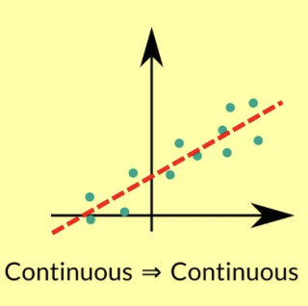
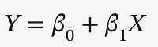
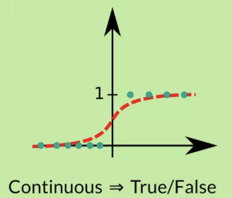
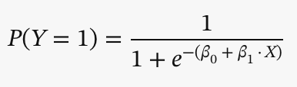
Supervised Learning Linear & Logistic Regression
Linear regression models are used to estimate the linear relationship between a continuous response variable and one or more continuous explanatory variables.
Applications of linear regression include prediction of blood pressure from drug dose, and quantitative traits in GWAS.
Logistic regression estimates the sigmoidal relationship between the binary response variable and one or more continuous explanatory variables.
Applications of logistic regression include prediction of heart attack risk from body weight, and binary traits in GWAS such as disease status.
Both linear and logistic regression assume explanatory variables have normal distributions.
When data follows a non-normal distribution (e.g. count data), generalized linear models can be used
Linear Regression
Logistic Regression

Slide 10
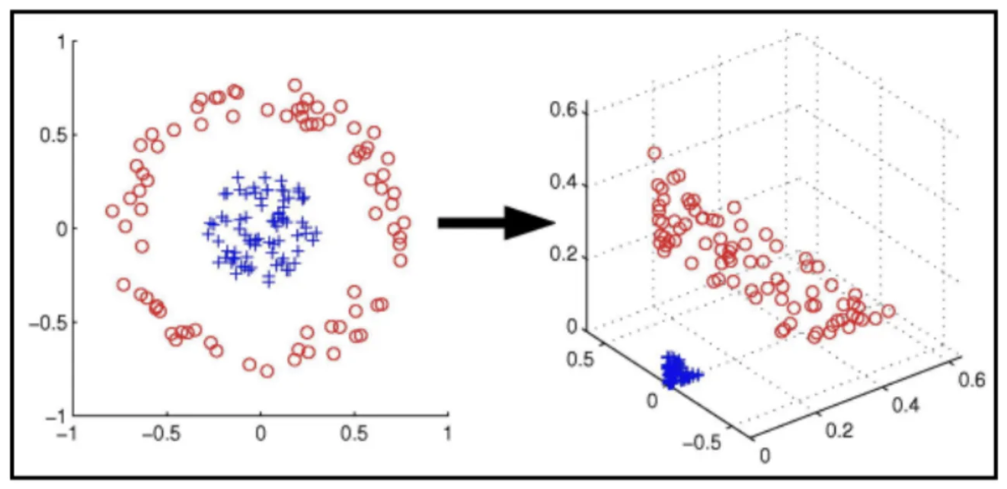
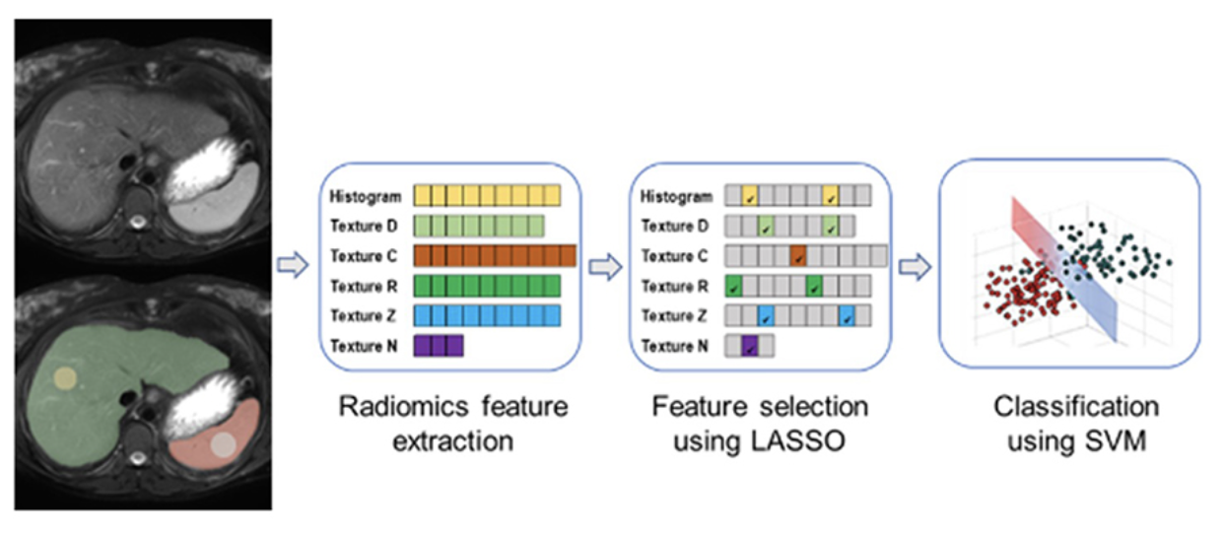
Support vector machines (SVMs)
SVMs are used for both classification and regression problems, and can handle larger, more complex data compared with regression.
In a binary classification problem, SVMs find a hyperplane that maximizes the margin between the two classes of data points.
In cases where the data is not linearly separable, SVMs use a technique called kernel trick to transform the data points into a higher dimensional space, where they can be separated by a hyperplane
Unlike regression, SVMs are effective on larger datasets with non-linear relationship between variables and are robust to outliers.
But model is more complex, meaning longer computations and harder to interpret.
SVM have many applications in disease classifications based on imaging features and prediction of drug toxicity and efficacy.
https://radiologyblog.cincinnatichildrens.org/prediction-of-fontan-outcomes-using-t2-weighted-mri-radiomic-features-and-machine-learning/

Slide 11
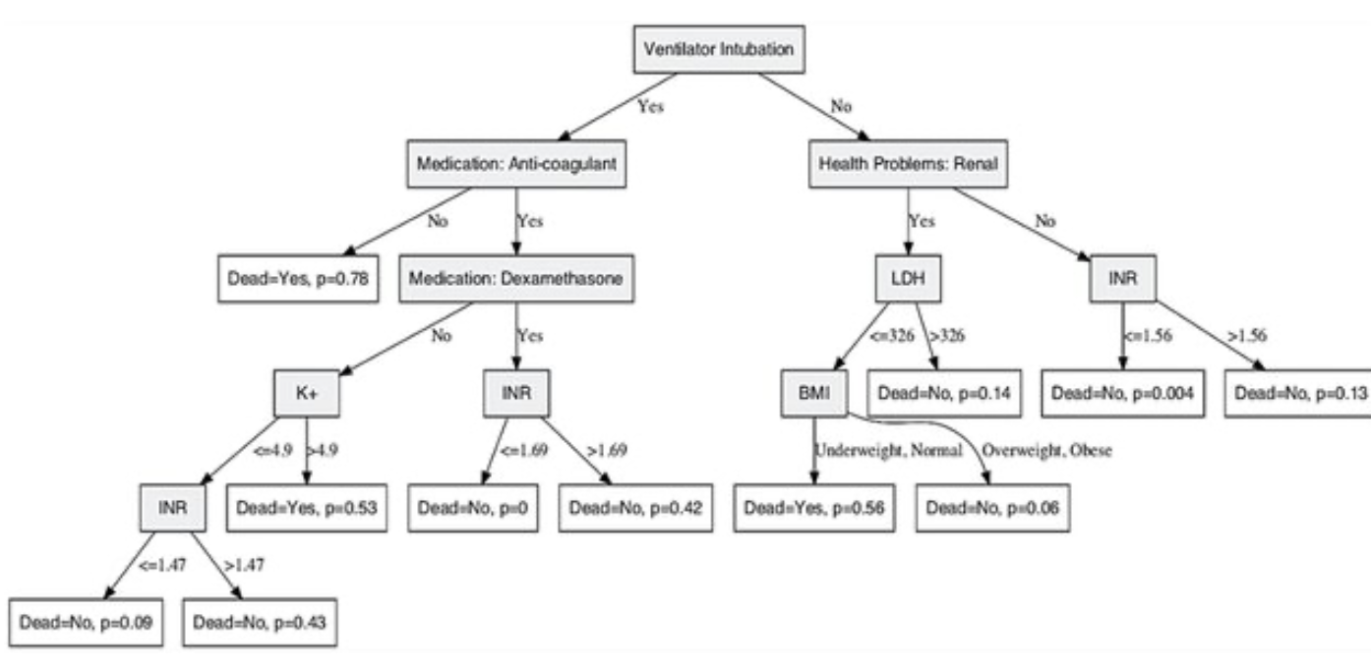
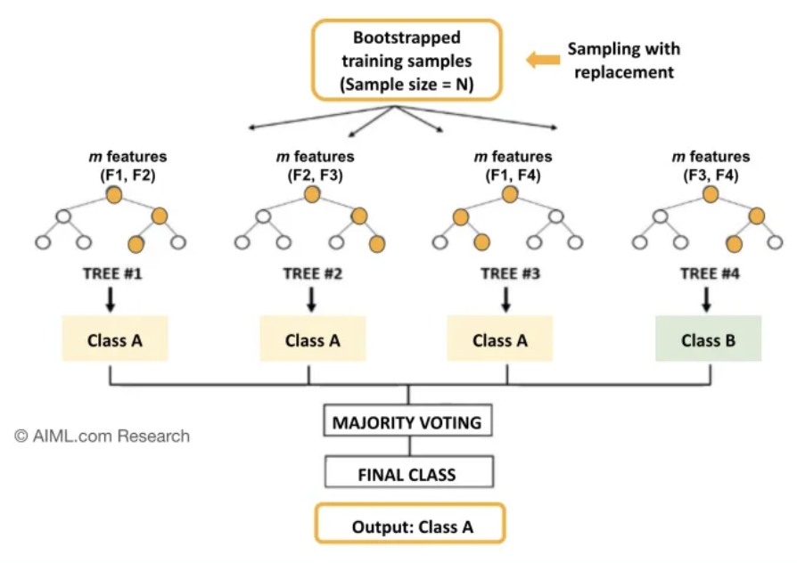
Tree-based methods
Decision Tree
Decision Trees are hierarchical structures that recursively partition the data based on the values of the input features.
Decision trees while versatile on many data types, are prone to overfitting, especially when they are deep and complex because they can easily memorize the training data.
This can be overcome by combining multiple decision trees trained on different subsets and features of the training data and averaging their results using a type of algorithm called Random Forest.
Random forests, are less prone to overfitting than decision trees due to their ensemble nature. Averaging the predictions across all the individual trees results in a more stable and accurate model.
Fast even on large dataset and have in-built feature selection ability. Can be used for survival prediction as well as classification.
A related algorithm called Gradient Boosting Trees can generate models with even greater accuaracy, at the expense of computation efficiency and risk of overfitting.
Random Forest

Slide 12
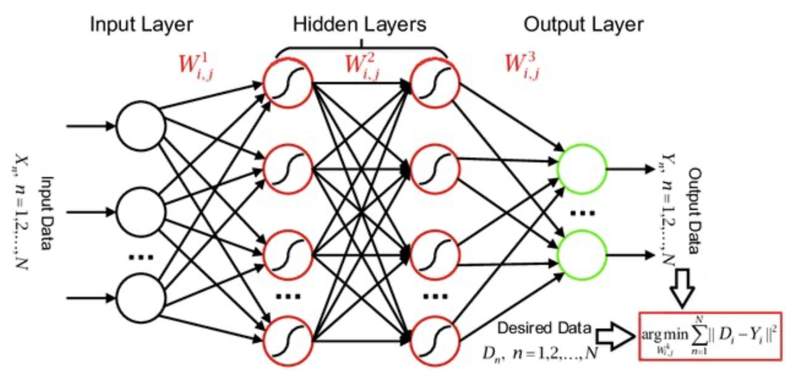
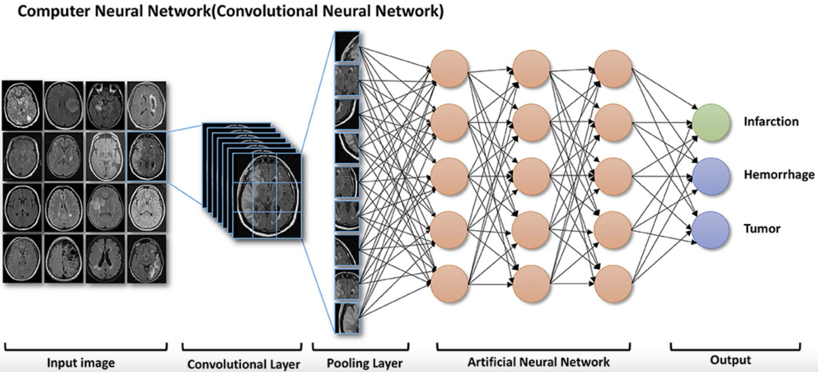
Artificial neural networks
Neural networks are a class of machine learning algorithms which use interconnected nodes or neurons in a layered structure that resembles the human brain.
Each neuron in a neural network applies an activation function (e.g. sigmoid, ReLU) to its input to produce its output
The weights and biases are the parameters of the neural network that are learned during training. The weights determine the strength of the connections between neurons, while the biases shift the output of a neuron.
Model training involves repeating steps of forward and backpropagation to update weights until the loss function is sufficiently minimized.
ANNs are particularly useful for unstructured data such as text, image and audio, where they usually outperform other ML methods
ANN able to learn complex patterns directly from raw data without the need for feature engineering
Applications include prediction of disease states from medical imaging analysis (e.g. MRI), EHRs, and COVID19 diagnosis from patient audio data
Activation Function
https://link.springer.com/article/10.1007/s11432-018-9596-5

Slide 13
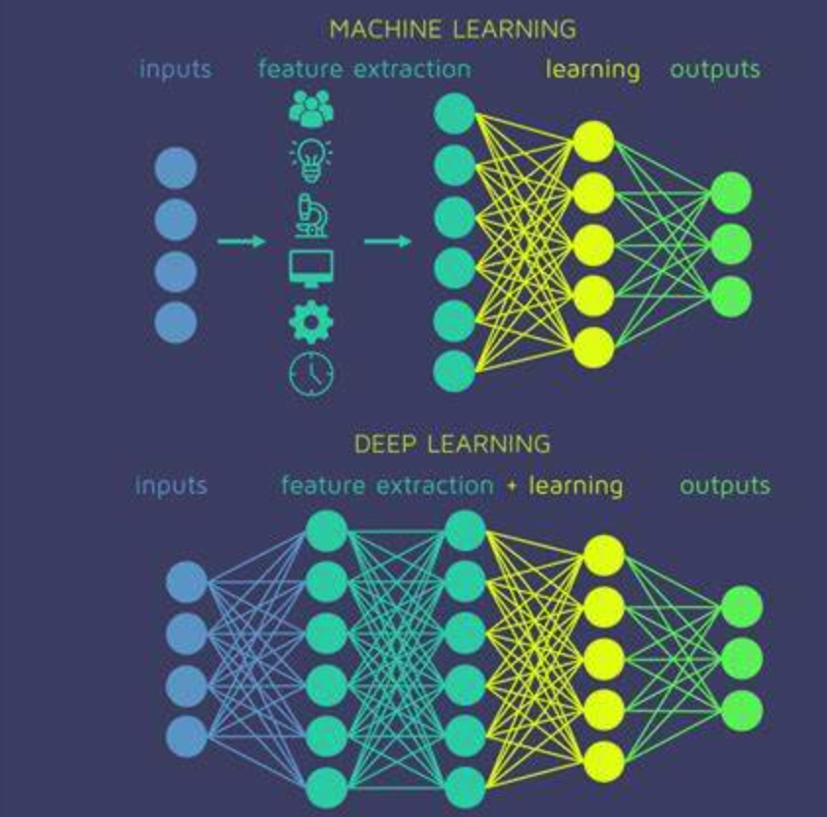
Deep Learning
Machine learning models typically involve fewer parameters and are more interpretable, but often require pre-selection and transformation of features by experts with domain-specific knowledge.
Deep learning models can involve millions of parameters and can identify the important features on their own without human intervention.
Deep learning models can achieve state-of-the-art performance on a wide range of tasks, but they require large amounts of data and computational resources to train.
In particular, two main types of deep learning have made significant impacts in medicine:
Deep convolutional networks used to segment medical images, such as MRI or CT scans to automate disease diagnosis and identify disease subtypes.
Transformer neural networks have been used to solve the protein folding problem and can predict protein structure based on sequence alone (e.g. AlphaFold). Also used for drug discovery and analysis of EHRs.

Slide 14
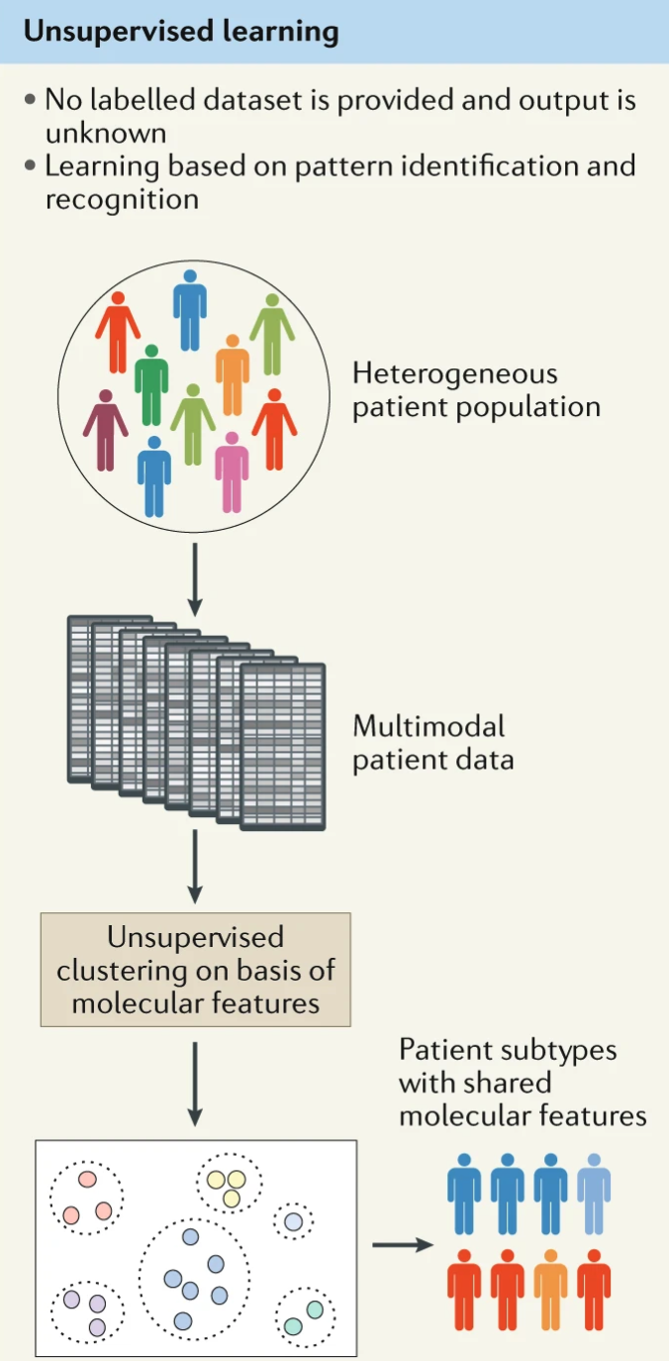
Unsupervised machine learning
Unsupervised machine learning is a type of machine learning where the goal is to find hidden patterns or structure in data without any predefined labels or categories.
The 3 most common types are: clustering, dimensionality reduction and association rule mining.
Applications
An important role in precision medicine, especially for less well studied or heterogeneous diseases.
Patient stratification. Identification of subgroups of patients with similar characteristics, such as genetic profiles, clinical features, or response to treatments, and can uncover different disease subtypes.
Drug repurposing. Can analyse large-scale drug and disease databases to identify potential new uses or applications for existing drugs by uncovering similarities between different diseases or drug targets
Single cell analysis. Essential for single cell omics to identify novel cell types and biomarkers in disease, and the precise cellular and molecular mechanisms of disease progression
Nat Rev Neurol 16, 440–456 (2020)

Slide 15
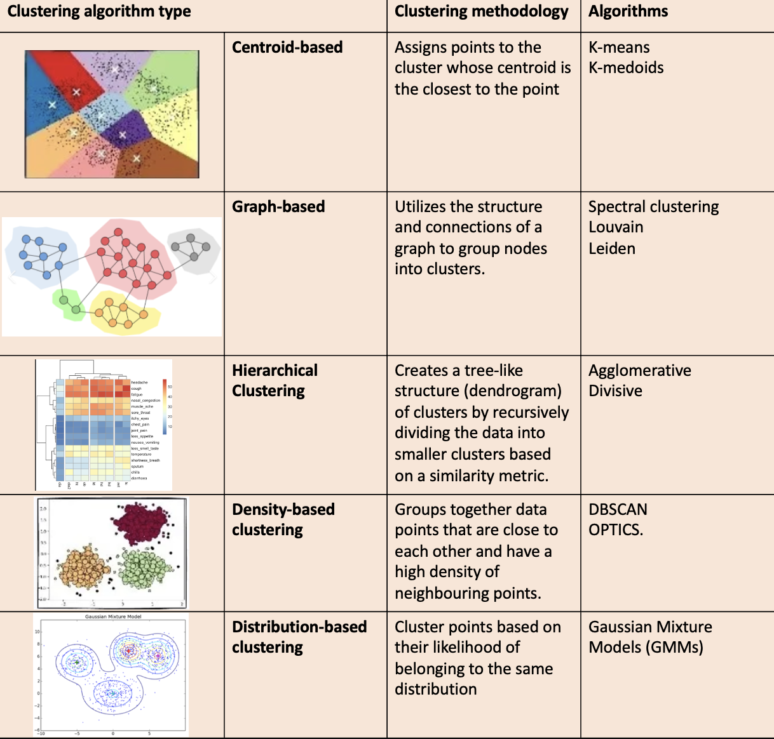
Clustering algorithms

Slide 16
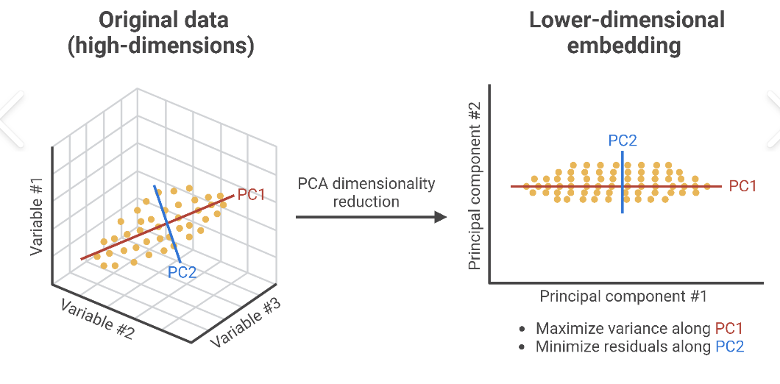
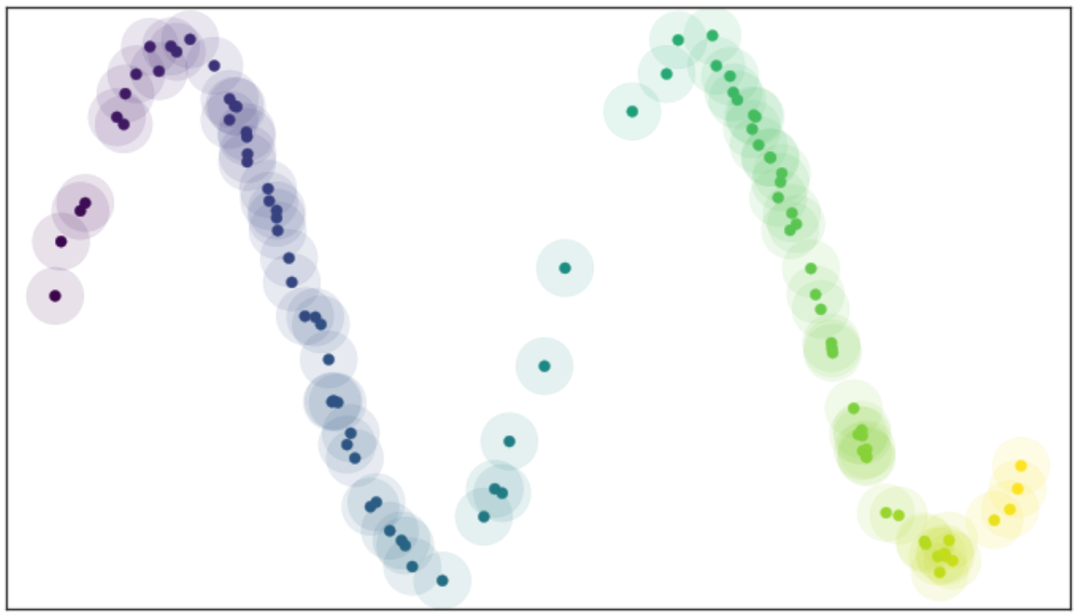
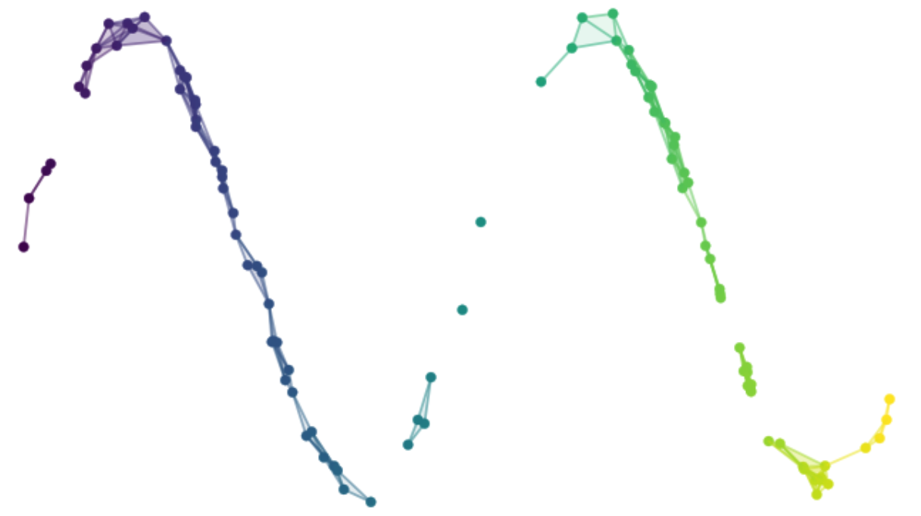
Dimensionality Reduction
Matrix factorization: PCA, NMF, SVA
Dimensionality reduction is a technique used to reduce the number of features or variables in a dataset while preserving as much relevant information as possible.
There are two main types: matrix factorization and Neighbour graphs
Matrix factorization dimensionality reduction aims to represent high-dimensional data in a lower-dimensional space by factorizing a data matrix into two or more lower-rank matrices.
Advantage is that they are fast and deterministic, and provide interpretable factors
Neighbourhood graph dimension reduction is a dimensionality reduction technique that is based on constructing a graph of the data points and then finding a low-dimensional embedding of the graph that preserves the pairwise distances between the data points.
Advantage is that they can capture non-linear and local structure of the data, while preserving global structure.
Suitable for complex datasets such as single cell omics, chemical compound databases for drug discovery and medical imaging
Neighbour graphs: UMAP, tSNE, Isomap

Slide 17




Machine learning libraries in R
H2O provides a platform for building and training a wide range of machine learning models.
Keras is a popular deep learning library originally developed for Python, but it has been ported to R as well
The caret package, short for Classification And REgression Training, is a comprehensive toolkit for supervised machine learning.
Rdimtools contains over 140 dimension reduction algorithms

Slide 18
R and RStudio installation
R: https://cloud.r-project.org/
RStudio: https://posit.co/download/rstudio-desktop/
Practical session
GitHub repo:
https://github.com/BioinfoHKUSurgery/Bioinfo-Workshop-2024

